Slide 1
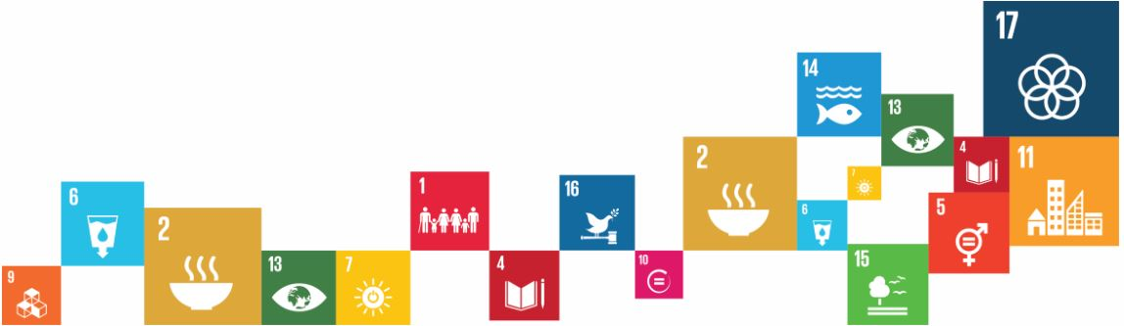
Creating Modern
Career Management Programmes for IO’s
Best Practices from the private sector and
a case study from UNDP

Slide 2

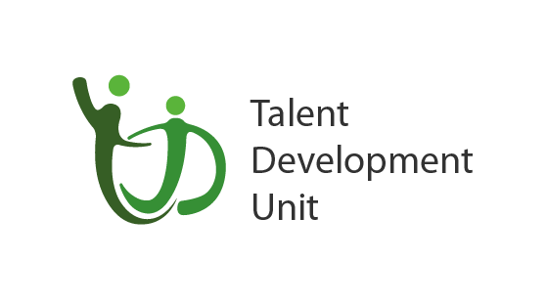
Acknowledgements
Promoting a Self-Driven and
Continuous Learning Culture @UNDP

Slide 3
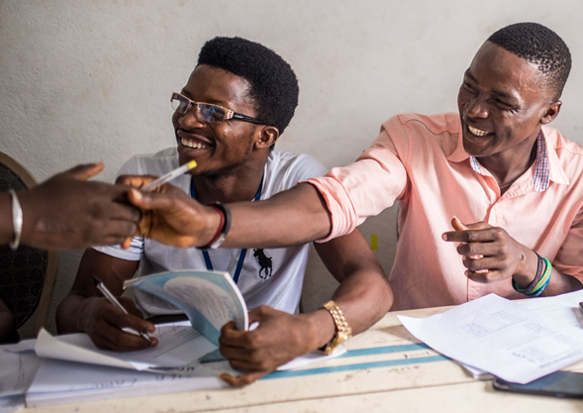
Career Management is
NOT
supporting people create job applications and prepare for interviews

Slide 4
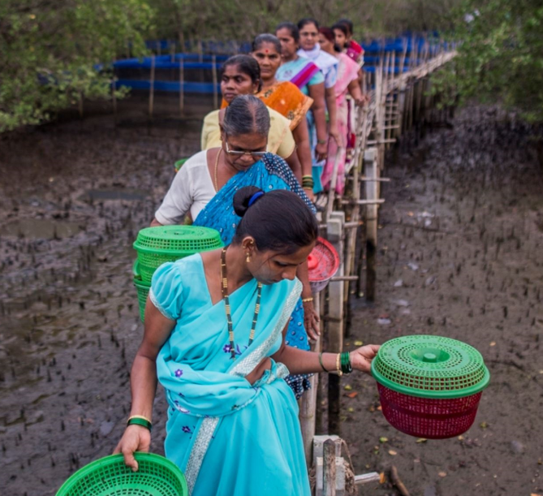
Agenda
What is career management and what is NOT?
New world of work and how it impacts IO’s
  Growth-based careers
Career Partnerships (Gartner / CEB)
Bersin Maturity Model and how it aligns with CM
The Business Case for CM:
  Alignment between CM and capability development
Best practice examples
Q&A

Slide 5
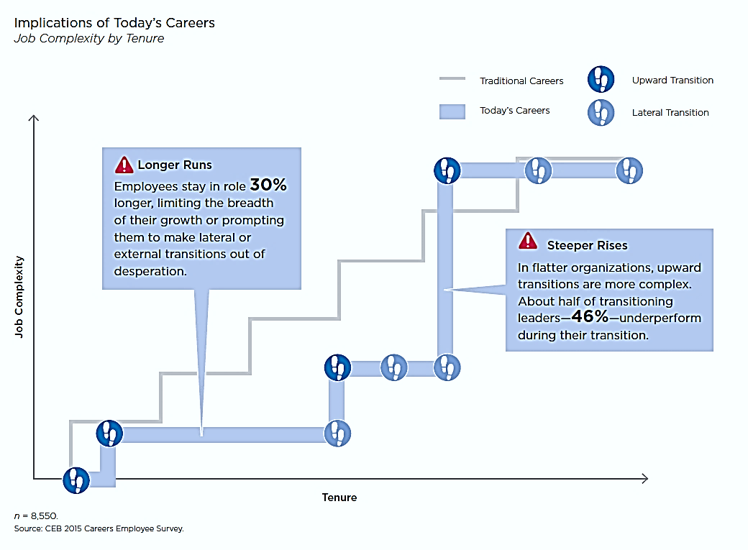
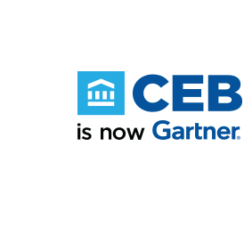

Changes in the Workplace
Notes:
CEB / Garner reports that upward and linear careers are unlikely to return. Most organizations have delayered their job hierarchies in the past decade and almost 75% of heads of HR don’t anticipate adding back layers in the next five years.
Flatter organizational structures mean longer time frames associated with upward movement. The new shape of the organization will continue to change the shape of careers.
Tenure in all levels has steadily increased about 30% over the past four years. This trend makes it difficult for employees to progress upward, causing many to leave the organization due to a perceived shortage of future career opportunities, or worse, stay and stagnate.

Slide 6

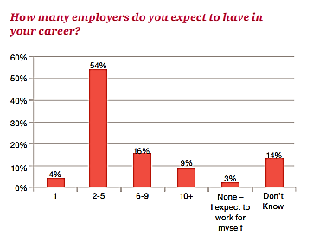
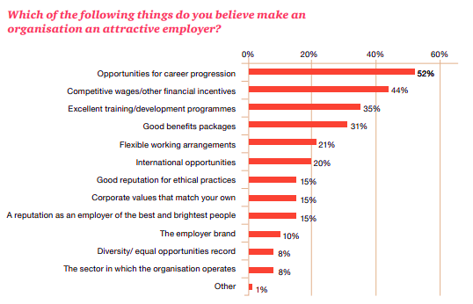
Changes in the Workplace
Notes:
CEB / Garner reports that upward and linear careers are unlikely to return. Most organizations have delayered their job hierarchies in the past decade and almost 75% of heads of HR don’t anticipate adding back layers in the next five years.
Flatter organizational structures mean longer time frames associated with upward movement. The new shape of the organization will continues to change the shape of careers.
Tenure in all levels has steadily increased about 30% over the past four years. This trend makes it difficult for employees to progress upward, causing many to leave the organization due to a perceived shortage of future career opportunities, or worse, stay and stagnate.

Slide 7
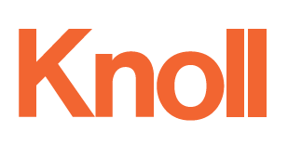
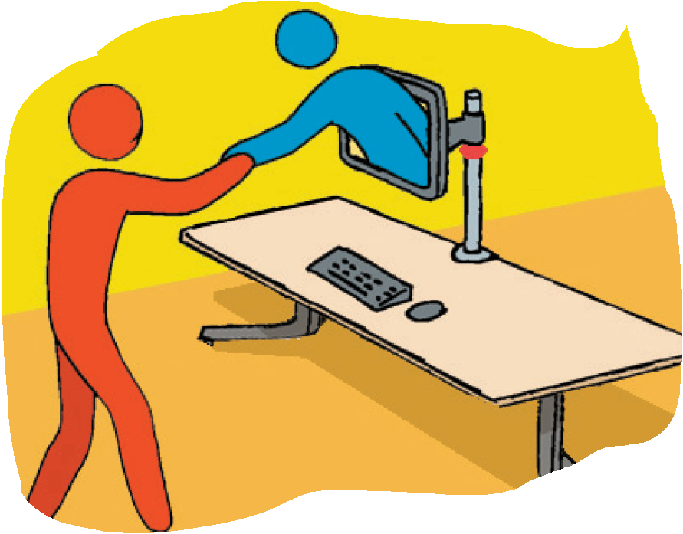
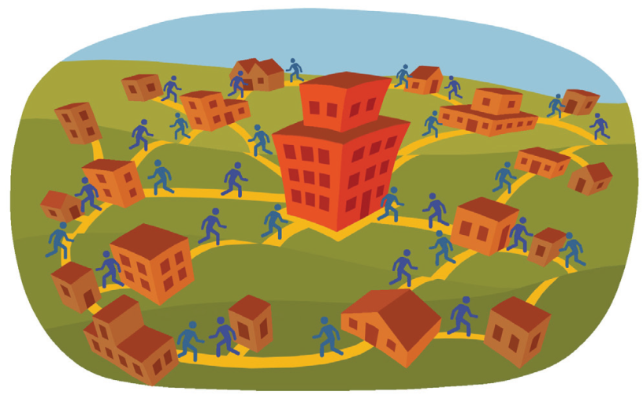
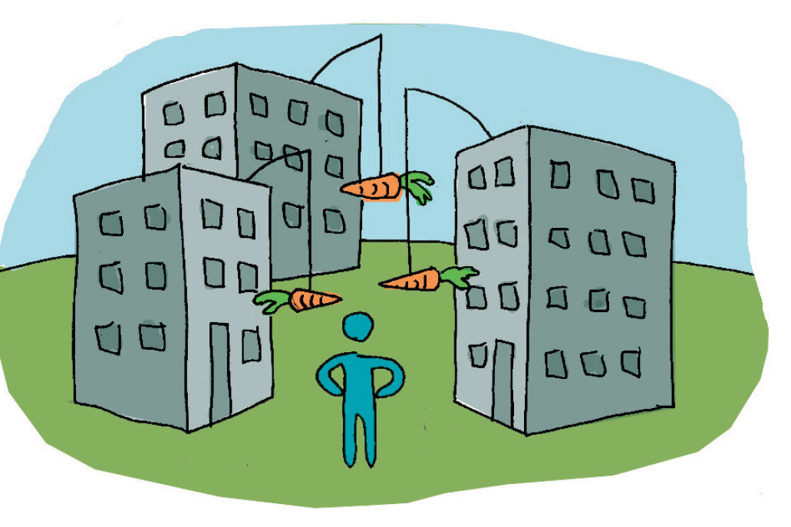
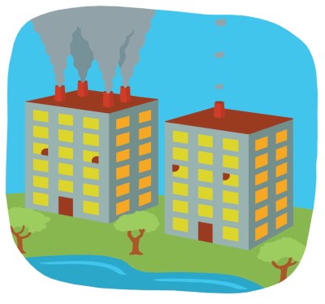
Five Trends Changing Work and the Workplace
Organizations as complex network of stakeholders
distributed around the world
Link conscious workplace strategies with social technologies and work policies.
Societal and regulatory drivers will pressure organizations to improve their sustainability work practices
Looming shortage of skilled knowledge workers
Need for more flexibility to attract and retain their best talent
Notes:
Five Implications for Work and the Workplace
These trends, in turn, are producing five major implications for organizations:
1. The continued distribution of workplaces. Centralized offices will evolve, providing a greater variety of
work settings to support collaboration and diversity of needs. Simultaneously, workers will increasingly
work in other distributed workplaces: at satellite offices, supplier and customer locations, off-shore
locations and home.
2. The challenge of keeping workers engaged and connected. As workers are more physically
dispersed, it becomes more difficult for them to engage with one another. To encourage socialization,
planners need to link conscious workplace strategies with social technologies, and work policies.
3. The difficulty of changing culture. The hardest part of changing the workplace is not the physical
environment or technology, it’s changing the people. The key to success is to give employees a voice in
the planning process, and allow them the choice of when, where, and how they work.
4. Adopting new workplace practices. With workers increasingly scattered geographically, work practices
need to adapt. Because it is no longer possible to communicate casually with a distributed work team,
leaders need to formalize good work practices for the team.

Slide 8
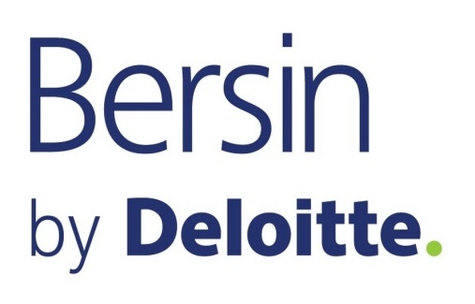
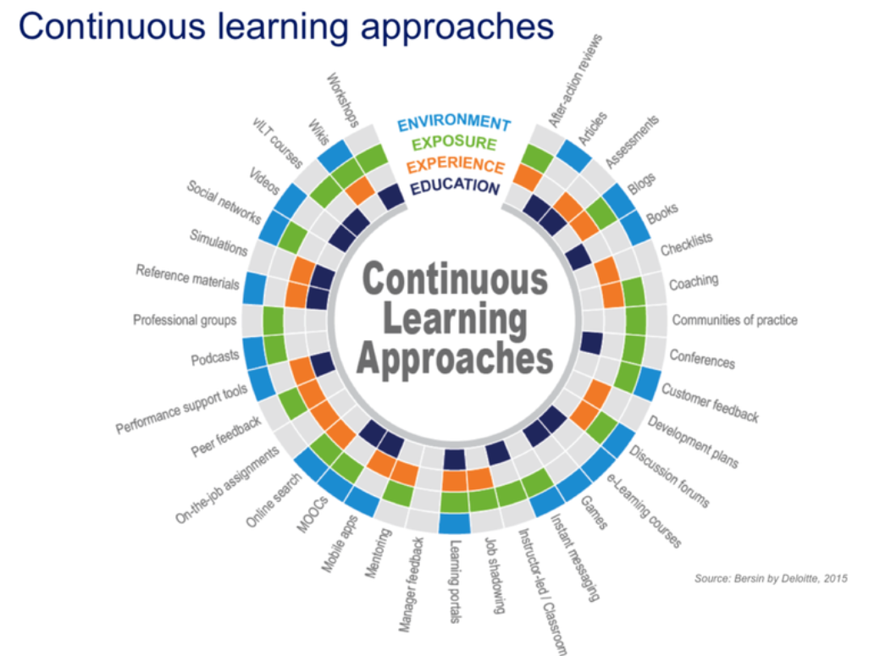
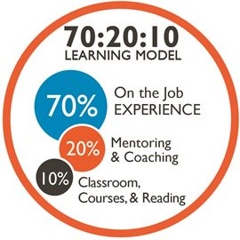
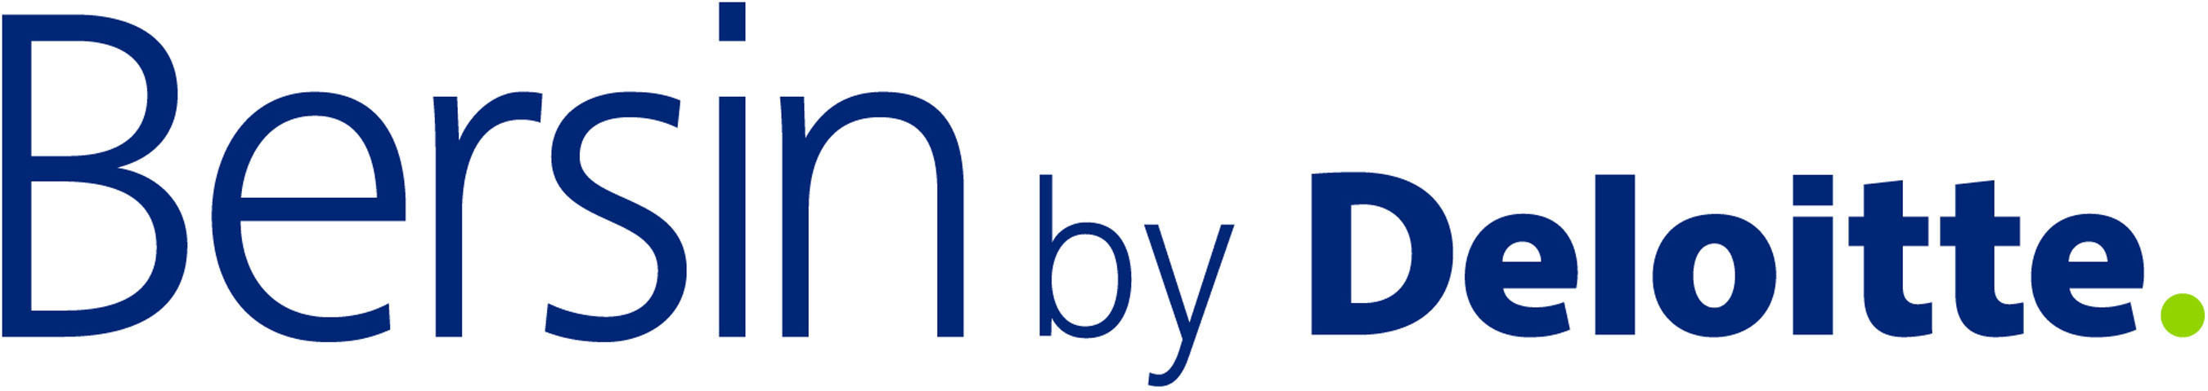
Learning Approaches and their impact on Career Management
X
Notes:
Why is continuous learning essential to a growth-based career?
Continuous learning refers to the ongoing development of skills, abilities, and knowledge throughout your career. This may be in the form of on-the-job assignments, peer feedback, social networks, professional groups, podcasts, mentoring, networking, job shadowing, formal and informal training. When we say “continuous,” we mean that traditional courses are no longer seen as the basic building block of learning. Rather, coursework is combined with several other elements that enable and encourage employees to learn in many ways. In summary, continuous learning goes beyond the traditional classroom experience and encompasses anything that will add value to your job and your career. Continuous learning enables and empowers employees to be better at their everyday jobs and prepare them for the future.

Slide 9
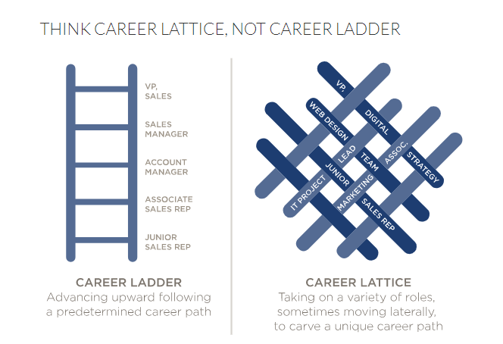
What is a growth-based career?
Notes:
What is a growth-based career?
Organizations that focus on growth-based rather than promotion-based careers foster more competitive career journeys for their employees. Growth-based careers prioritize experiences over promotions.
The career ladder is the typical representation of a promotion-based career culture. In this context, employees focus on their next promotion and typically stay within a functional area for their whole careers. Career moves are driven by career dissatisfaction. In this model, employees change jobs as a result of vacancies becoming available within their area of expertise.
On the other hand, a growth-based career culture focuses on employees obtaining new experiences to build their skills. Instead of staying within an organizational silo, employees are encouraged to move between different parts of the organization or across organizations. Career moves are then no longer driven by dissatisfaction, but by growth opportunities which are aligned with employees’ preferences and business needs.
The career lattice is the best representation for a growth-based career model since it places you in charge of your own advancement. Career lattices provide more flexibility than career ladders. Lattices allow you to develop cross-functional and leadership skills by cultivating a broader range of expertise and provide you visibility in the organization. This makes you more valuable not only to UNDP, but also to the marketplace as a whole. A career lattice will allow you to determine the speed, the direction and the timing of your move. Most importantly, a growth-based career allows you to pursue your interests, values and goals while supporting the organization fulfil its mission.
To summarize, career models must now be dynamic, flexible, open and agile. This means that career progression is no longer exclusively linear and upwards. In order to continue learning, employees are encouraged to think about their careers in terms of growth and experiences instead of focusing on getting to the next promotion.

Slide 10
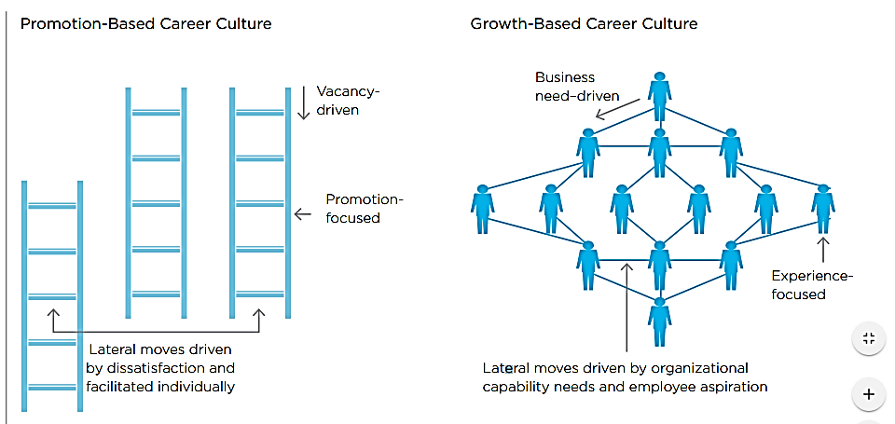
What is a growth-based career?
Notes:
What is a growth-based career?
Organizations that focus on growth-based rather than promotion-based careers foster more competitive career journeys for their employees. Growth-based careers prioritize experiences over promotions.
The career ladder is the typical representation of a promotion-based career culture. In this context, employees focus on their next promotion and typically stay within a functional area for their whole careers. Career moves are driven by career dissatisfaction. In this model, employees change jobs as a result of vacancies becoming available within their area of expertise.
On the other hand, a growth-based career culture focuses on employees obtaining new experiences to build their skills. Instead of staying within an organizational silo, employees are encouraged to move between different parts of the organization or across organizations. Career moves are then no longer driven by dissatisfaction, but by growth opportunities which are aligned with employees’ preferences and business needs.
The career lattice is the best representation for a growth-based career model since it places you in charge of your own advancement. Career lattices provide more flexibility than career ladders. Lattices allow you to develop cross-functional and leadership skills by cultivating a broader range of expertise and provide you visibility in the organization. This makes you more valuable not only to UNDP, but also to the marketplace as a whole. A career lattice will allow you to determine the speed, the direction and the timing of your move. Most importantly, a growth-based career allows you to pursue your interests, values and goals while supporting the organization fulfil its mission.
To summarize, career models must now be dynamic, flexible, open and agile. This means that career progression is no longer exclusively linear and upwards. In order to continue learning, employees are encouraged to think about their careers in terms of growth and experiences instead of focusing on getting to the next promotion.

Slide 11



Building Effective Career Partnerships
Employee
Manager
Notes:
What is my role?
You are in the driving seat of your career path to ensure you own success. As part of your career journey at UNDP, we expect you to initiate and prepare for career development conversations with your supervisors. It is important for you to understand and be prepared to articulate your strengths and career aspirations. Managing your career is an ongoing endeavor. Maintaining a growth-mindset and learning every day will help you on your career path. In order to do so, you will find resources on our career management portal.
As the United Nations system evolves, UNDP will continue playing a pivotal role in the pursuit of the Sustainable Development Goals. You should take advantage of opportunities to learn about the skills and experiences UNDP needs to fulfil the 2030 Agenda. The key is to understand where our organization is growing and how our mission is developing. For the duration of your assignment at UNDP, we encourage you to build your network with peers, managers and leaders inside and outside the United Nations System.
What is my manager’s role?
Managers at UNDP are responsible to empower employees to reflect, consider options and pursue developmental opportunities in line with personal and organizational goals. They should also be accountable for supporting personnel in reinforcing new skills over time.

Slide 12
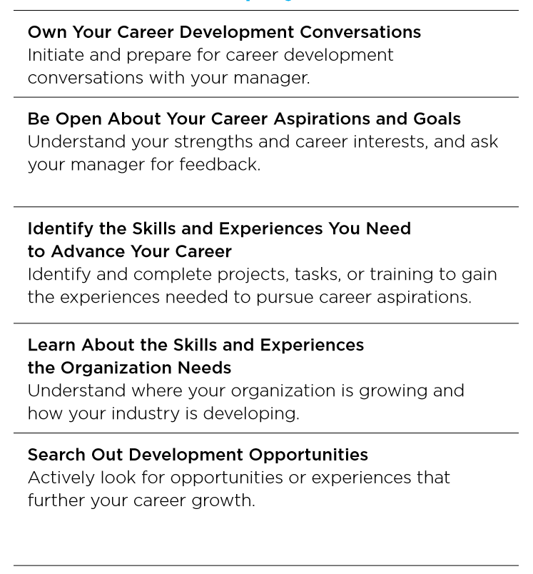
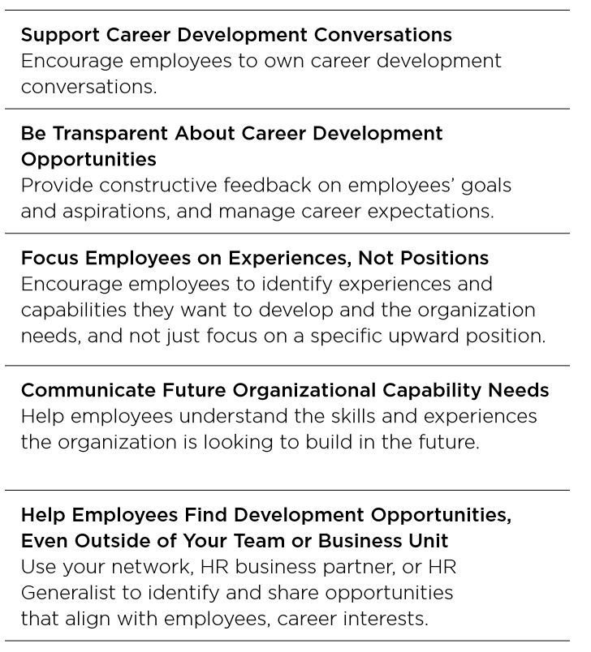

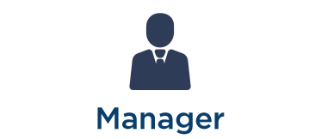
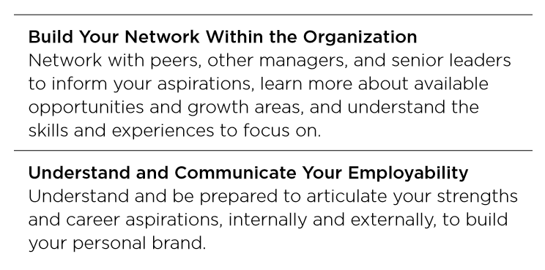
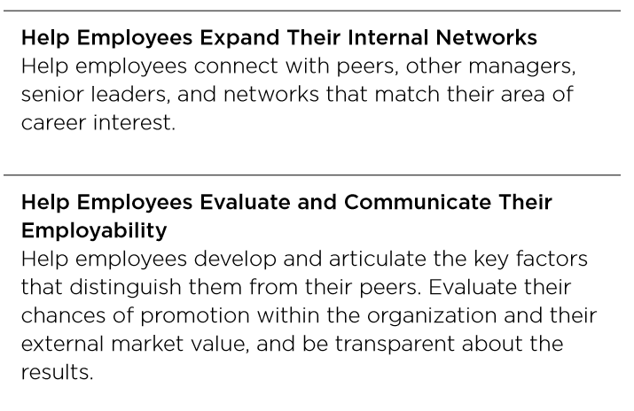
Building Effective Career Partnerships
Notes:
What is my role?
You are in the driving seat of your career path to ensure you own success. As part of your career journey at UNDP, we expect you to initiate and prepare for career development conversations with your supervisors. It is important for you to understand and be prepared to articulate your strengths and career aspirations. Managing your career is an ongoing endeavor. Maintaining a growth-mindset and learning every day will help you on your career path. In order to do so, you will find resources on our career management portal.
As the United Nations system evolves, UNDP will continue playing a pivotal role in the pursuit of the Sustainable Development Goals. You should take advantage of opportunities to learn about the skills and experiences UNDP needs to fulfil the 2030 Agenda. The key is to understand where our organization is growing and how our mission is developing. For the duration of your assignment at UNDP, we encourage you to build your network with peers, managers and leaders inside and outside the United Nations System.
What is my manager’s role?
Managers at UNDP are responsible to empower employees to reflect, consider options and pursue developmental opportunities in line with personal and organizational goals. They should also be accountable for supporting personnel in reinforcing new skills over time.

Slide 13
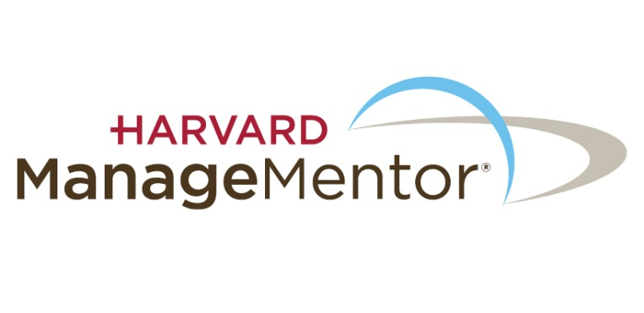
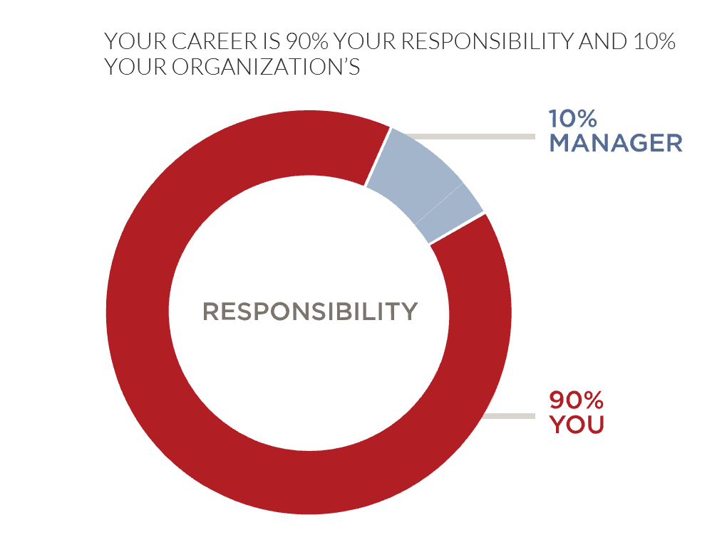
A Growth-Based Career Model
Notes:
French:
Vous trouvez ici une brève description de la façon dont les career partnerships sont conceptualisés et comment nous pourrons, nous le PNUD tirer parti de ce modèle pour favoriser le développement de la carrière du personnel.
---------------------------------------------------------------------------------------------------------------------------------------------------------------------------------------
English:
Mariam to provide brief description of how these career partnerships are conceptualized and how we at UNDP can leverage this model to foster career development for staff.
https://www.forbes.com/sites/jimmyrohampton/2017/03/17/5-smart-hacks-for-building-your-personal-brand-on-linkedin/#7830598328f3

Slide 14
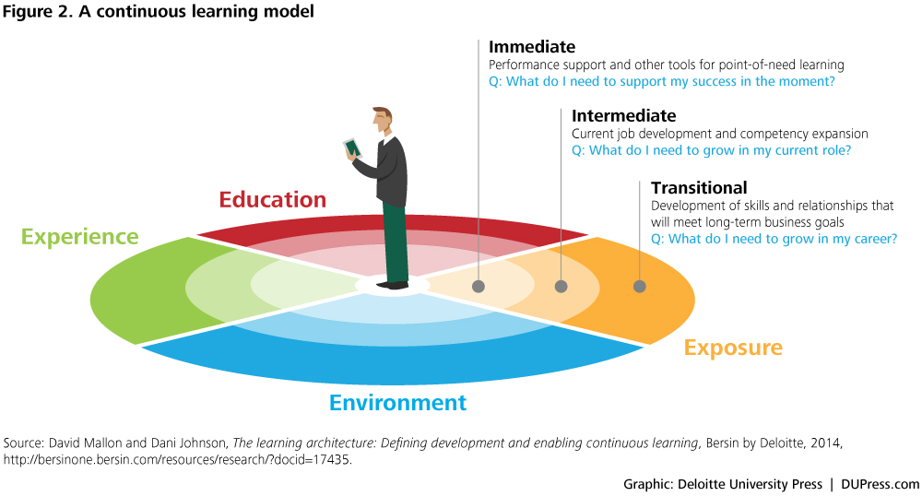
Continuous Learning and growth-based careers?
Notes:
Why is continuous learning essential to a growth-based career?
Continuous learning refers to the ongoing development of skills, abilities, and knowledge throughout your career. This may be in the form of on-the-job assignments, peer feedback, social networks, professional groups, podcasts, mentoring, networking, job shadowing, formal and informal training. When we say “continuous,” we mean that traditional courses are no longer seen as the basic building block of learning. Rather, coursework is combined with several other elements that enable and encourage employees to learn in many ways. In summary, continuous learning goes beyond the traditional classroom experience and encompasses anything that will add value to your job and your career. Continuous learning enables and empowers employees to be better at their everyday jobs and prepare them for the future.

Slide 15
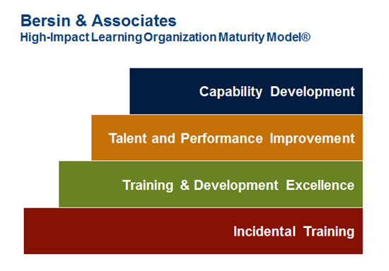
Bersin Maturity Model and Career Management

Slide 16
Why is it important to me and to my organization?
Capability Building
Sense of Autonomy
Employee Engagement
Job Satisfaction
Careers Designed around experiences
Growth and enhanced employability
Work-Life Balance
Motivation
Notes:
Why is a growth-based career important to me and to UNDP?
A growth-based career will allow you to gain new experiences that will increase your employability over time. These new experiences may vary for different people and may include enriching stretch assignments (in person or even virtually), cross-functional short-term projects, and creative lateral or downward moves.
Research has indicated that both employers and employees benefit from designing careers around experiences rather than promotions. Organizations that adopt a growth-based career model benefit from building capability to meet changing organizational needs and increases employee engagement and motivation. Employees who engage in growth-based careers report higher levels of job satisfaction, increased sense of autonomy in the workplace and better work-life balance. These are just a few examples of why a growth-based career is important to you and to UNDP.

Slide 17
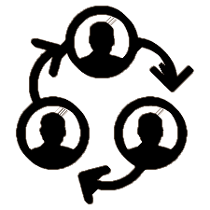



What’s the organization’s role?
Build Accountability among supervisors
Offer state-of-the-art Technology
Provide dynamic environment of continuouus learning opportunities
Increase CM capabilities via tools
Notes:
Build accountability: Enable employees to become accountable for managing their careers by providing them with ongoing support and career resources that will help them increase their awareness of strengths, skills and interests to continually align and add value to business needs.
Increase Career Management Capabilities: Provide managers and leaders with tools to enhance their confidence and competence in conducting, ongoing Career Conversations with their employees.
Offer state-of-the-art resources: Provide robust, easily accessible, career management technology resources that help employees develop needed skills and knowledge to grow their careers and meet emerging talent needs.
Promote a dynamic environment of continuous learning: learning is always on and always available and flexible opportunities to apply new knowledge, skills and abilities.
What is UNDP’s role?
Our goal is to align career management with capability and leadership development of employees at all levels. In order to accomplish this, UNDP is focusing on the following:
Build accountability: Enable employees to become accountable for managing their careers by providing them with ongoing support and career resources that will help them increase their awareness of strengths, skills and interests to continually align and add value to business needs.
Increase Career Management Capabilities: Provide managers and leaders with tools to enhance their confidence and competence in conducting, ongoing Career Conversations with their employees.
Offer state-of-the-art resources: Provide robust, easily accessible, career management technology resources that help employees develop needed skills and knowledge to grow their careers and meet emerging talent needs.
Promote a dynamic environment of continuous learning: learning is always on and always available and flexible opportunities to apply new knowledge, skills and abilities.

Slide 18
Value Proposition
Ability to bolster employee engagement, increase satisfaction and optimize performance, which should have a direct impact in the organization’s objectives;
Increase in capability and upskilling of existing staff and allow organization to leverage in-house strengths;
Prepare staff to become more competitive for internal opportunities, other multilateral organizations, or even the marketplace in general
Enhance your organization’s Employer Value Proposition as it becomes a workplace offering a higher-impact career journey for those already employed and those considering us as part of their career journey

Slide 19
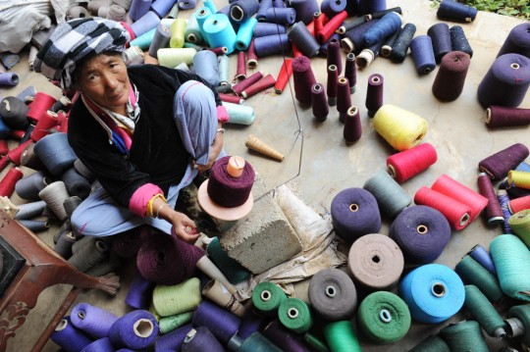
Translating
Value Proposition
into
Priorities

Slide 20

Priorities
Creating a Culture of Growth-Based Career Management
Support to Gender Parity Strategy
Support to National and local Staff
Support to Departments
Notes:
Employer of choice
Mini-case study
Disruptive
Gender work as part of initiative
Potential ROIs – retention – increase in engagement as per survey –

Slide 21

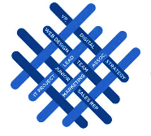



Sample Initiatives that could support priorities
Creating a Culture of Growth-Based
Careers
Career Management Framework
Virtual Career Labs
Career ManagementPortal
Continuous Learning
…
Support to Departments
Career Management Services offered to CO’s undergoing restructure
Training of key stakeholderss in Career Coaching Techniques to provide support virtually or on the field
Support to Gender Parity
Career Management Programmes for Women
Special VCL Themes
Speed Mentoring
Support to local and national staff
Multi-themed Toolkits to facilitate
Career Conversations between employees
and managers
Creation of a High-Potential Programme and Opportunities for development assignments for national staff
Notes:
French:
Juste un rappel, cette session devrait être interactive. Par conséquent, vous serez également inviter a faire un peu de travail en prenant des notes. Ils faut noter que toutes les informations ne sont pas ou devraient sur les slides. C'est une séance dans laquelle nous voulons que vous réagissiez et preniez des décisions sur ce que vous considérez important a suivre pour votre carrière professionnelle.
---------------------------------------------------------------------------------------------------------------------------------------------------------------------------------------------
English:
Just a reminder that this should be an interactive session. Therefore, you also have to do some of the work in taking notes. Not everything is on the slides or should be on the slides. This is a session in which we want you to take action and make decisions for yourself on what you consider important.

Slide 22

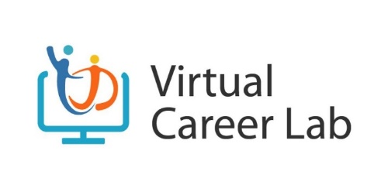

Slide 23

UNDP #careerexperience pitch-off
Our company
ABOUT US
UNDP works in nearly 170 countries and territories, helping to eradicate poverty, reduce inequalities and build resilience so countries can sustain progress. As the UN’s development agency, UNDP plays a critical role in helping countries achieve the Sustainable Development Goals.
UNDP is an agile and nimble organization operating closer to the field. UNDP’s new structure reflects more employees working in country offices and regional hubs to strengthen our support on the ‘ground’. As the convenor and integrator in the UN System, UNDP’s role in the field is pivotal to other organizations as well.
For two consecutive years, the Aid Transparency Index has recognized us as the most transparent development agency in the world.
NO. EMPLOYEES
18K
REGION
GLOBAL
INDUSTRY
AID
Notes:
If I am to describe UNDP in a few words, I could use:
170 countries and territories
Erradicate Poverty
Reduce Inequalities
Build Resilience
Sustain Progress
We are 18K employees across the world with multiple cultures, languages, races and ethnicities with a variety of contract types and arrangements.
As you can imagine, the expectations of employment and career development can vary dramatically from office to office given this type of setup.

Slide 24
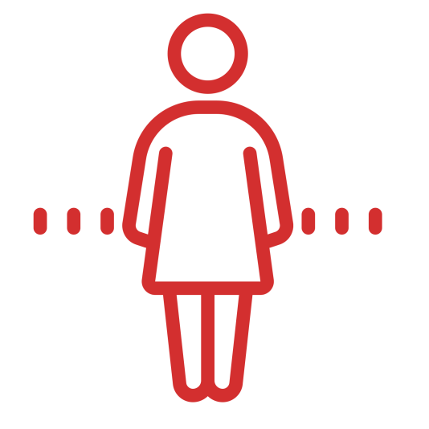


UNDP #careerexperience pitch-off
Challenge
Global Staff Survey 2016 Insights
Career experience discrepancies across personnel, especially women and millenniums
Differing career/development opportunities based on types of contract
Culture and expectations need to refresh with changes in UN System and workforce.
Focused on career ladders not experiences.
Notes:
The latest Global Staff Survey provided us the following insights into the Career Experiences of our employees:
Grave discrepancies in career experience, career expectations and understanding of one’s role, manager’s role an UNDP’s role in managing one’s career
Varying career development opportunities based on types of contracts
Focus on career ladders and not on career experiences as part of one’s career journey. As the UN System and UNDP changes to accommodate realities of ‘mission, marketplace, new generations and the psychological contract between employer and employee, this is an important item to tackle.
The Talent Development Unit has created a career management pillar, which I have headed since June 2017. Among many programmes and initiatives, here’s a special programme we have designed to promote a culture change across the organization: (move to next slide)

Slide 25
UNDP #careerexperience pitch-off
Solution
Promotion of a self-driven and continuous learning culture
Low cost, high hmpact and wide-reaching
Exposure to private sector, non-profit, academia & gov. practices and insights
Align career management with capability development
Before and after session-assignments, and live interaction
Promote Culture Change
Notes:
We launched a new strategy for talent development in 2017 – to create a practice-driven culture through CONTINOUS LEARNING. Our goal is to empower ~18K personnel to reach their full potential and create a work environment of alignment between personal and organizational growth.
The Virtual Career Lab initiative was conceptualized as a low-cost and high-impact way to link career management and learning. It provides insights and resources to a multicultural and geographically-diverse population with varying career development needs. This is aligned with the continuous learning model where opportunities are “always on and always available” to all employees across the talent spectrum. As we promote a career-growth model, we also cover the 3E’s (Experience, Exposure and Environment).

Slide 26
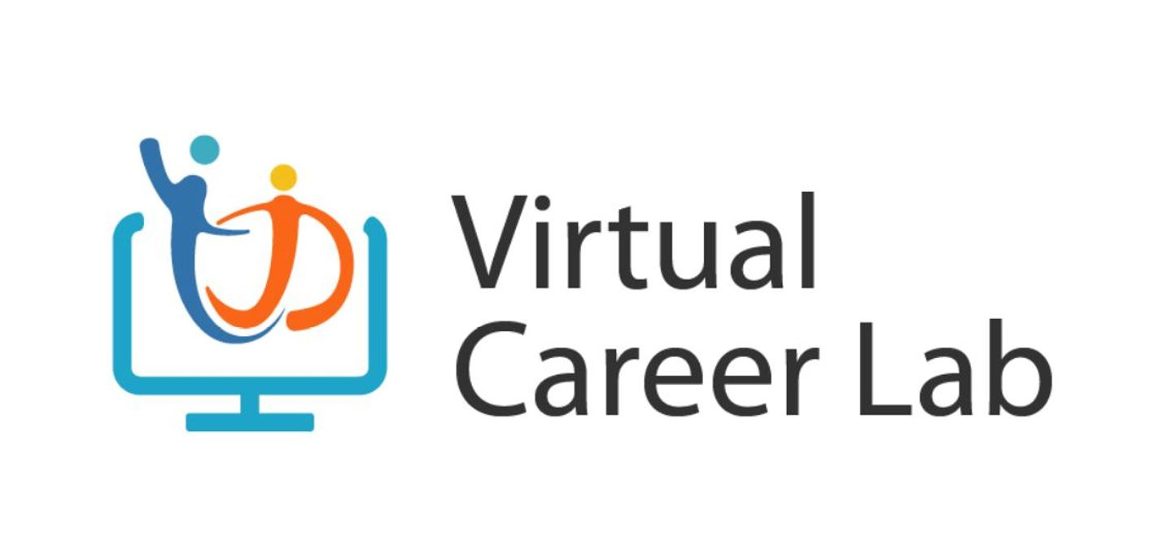
UNDP #careerexperience pitch-off
Always-on
&
Always available
Solution
Promote Culture Change
Notes:
By 2019, our goal is to move UNDP forward in the Bersin’s Maturity Model for Corporate Learning Scale for High Impact Talent Development from a Level 2 (Training and Development Excellence) to a level 4 (Capability Development).
The labs create a dynamic environment of “learning by doing” where employees gain career management skills by adopting self-driven career management behaviors. We focus our pre-session assignments, topics, speakers, and frequency on factors that promote a continuous learning culture by:
1) Collecting information from all registrants to assess their needs and curate content that fits their goals.
2) Scheduling labs on a bi-weekly basis and making recordings available any time to all employees.
3) Inviting speakers from other multilateral organizations, not-for profit, private sector and academia to provide different perspectives and insights into common career questions.
4) Aligning career management with capability enhancement by designing and curating content that will increase participants’ employability and impact while in the organization.
5) Creating interactive presentations with pre-assignments, in-session polls and exercises and question breaks to encourage learning and discussions before, during and after the event.
6) Involving multiple stakeholders and providing resources to be followed up by the employees themselves and their managers.

Slide 27
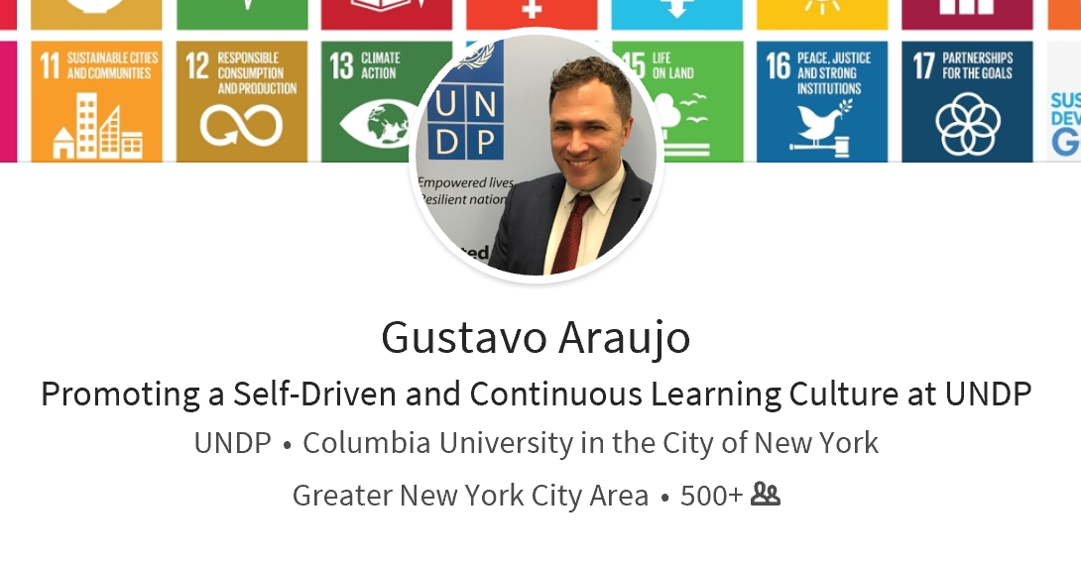
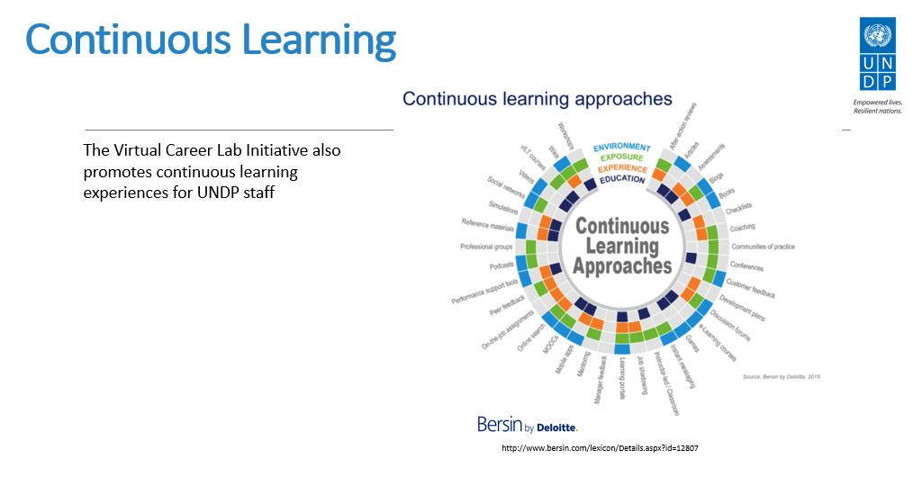

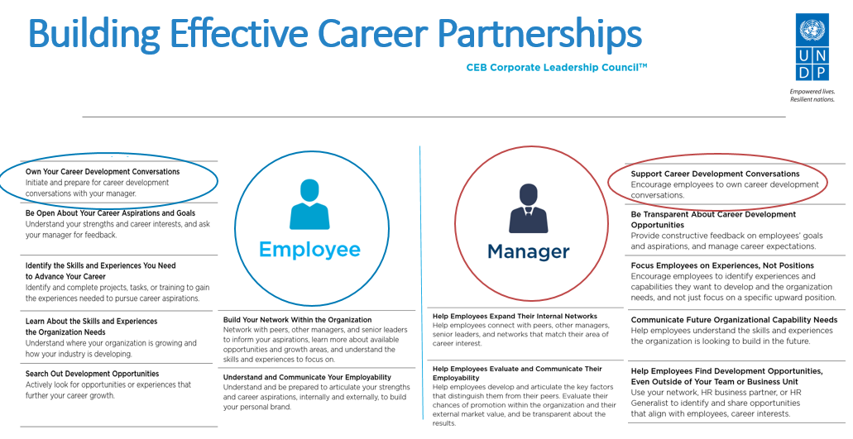

UNDP #careerexperience pitch-off
Communication
Talent Development Manager Network (>150 champions)
Notes:
Research from the Association for Talent Development published earlier this year reveals that only 31 percent of organizations have a “culture of learning.”
According to CEB, a corporate learning culture can lead to better business results for the organization, with people in this type of working environment performing 12 percent better than those without access to the same resources.
Bersin by Deloitte suggests that key components of a learning culture include building trust, encouraging reflection, enabling knowledge-sharing, and empowering employees.
We incorporated these concepts not only in creating the VCLs, but also in communicating about this initiative. We used a multi-tiered communication approach using the IMPACT HR model of communication:
1) Actively shared the continuous learning framework with personnel at all levels, including senior managers. Our goal was to sensitize employees to a new approach to learning.
2) Promoted the 4Es of continuous learning in all programmes from leadership development to skills training on UNDP core areas.
3) Tagged the continuous learning model on team’s LinkedIn profiles, internal yammer profiles and email signatures.
4) Created leader-led sessions with senior manager champions who shared examples of how they created a culture of continuous learning.
By the time the VCL initiative was launched in June 2017, employees were already exposed to the Continuous Learning Model.
VCL announcements are shared bi-weekly with multiple communities including 150 Talent Development Managers across the globe, HR Business Partner teams and key stakeholders across the organization. Announcements are also shared on multiple internal networks including UNDP Yammer pages that cater to diverse areas of expertise.
Our challenges include communicating to audiences across time zones with varied levels of English proficiency and of employment opportunities in over 170 countries and territories.
Post-session announcements on LinkedIn also increase awareness to employees and HR practitioners so this type of initiative can be emulated and adapted to different organizations over time.

Slide 28






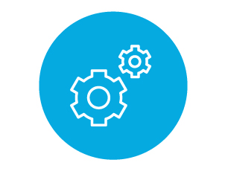




Virtual Career Lab Topics
Job Crafting: Growing within Your Current Job |  | Preparing for Video Interviews
Preparing for a Competency-Based Interview |  | Having Career Conversation with your Supervisees
Making the Most of Your LinkedIn Profile |  | Having Career Conversations with Your Supervisors
Career Stories: From National Officer to International Positions |  | Personal Branding and Career Management
Preparing a Job Application |  | Careers of the Future
Notes:
Here are some of the topics we have delivered live to our employees. We have also made the recordings available on-demand so they are ‘always on and always available’ to anyone who works at UNDP, regardless of contract type.
Just this Monday, 27 November 2017, we ran the lab “Having Career Conversation with your Supervisees,” which attracted close to 400 registrations.
The topics in the dotted lines are topics scheduled for December and early next year. We also work closely with the Engagement Unit to support the Women’s Development Programme.

Slide 29


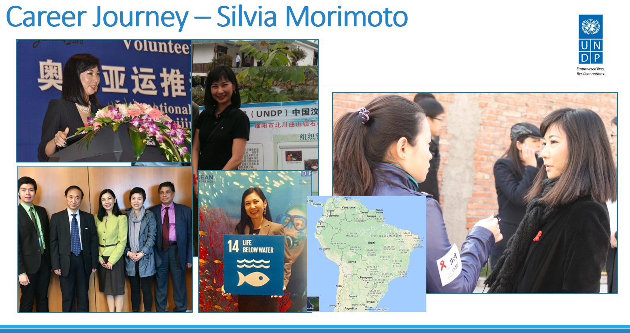
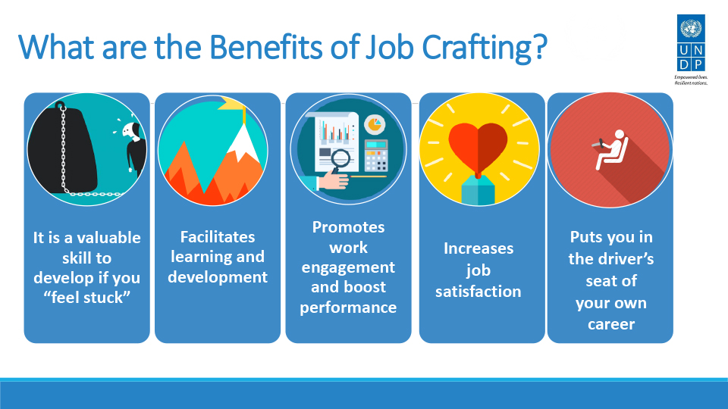
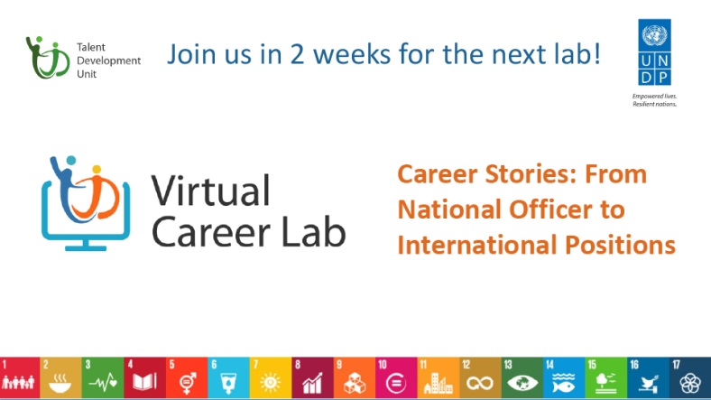
Slide Samples
Notes:
As you can see in the sample above, besides reinforcing the idea of the continuous learning model on every presentation, we also curate content to meet the varying needs of our employees. Whether they would like to get ready for a new job or make the most of the current job they have, we carefully curate content from top players in the industry and also rely on our own staff for leader-led sessions to inspire employees.
The first slide shows one of our topics of conversation for the session titled “Career Stories: From National Officer to International Positions.”
The second slide shows the career journey (In pictures) of one of our strong female leaders who moved on from intern all the way to Country Director in Myanmar this year.
The slide on job crafting shows the our to encourage people to develop while on their current job. After all, career development is not just about promotion. It is also about doing the best and developing with the opportunities you currently have.
At the end of every VCL, we tend to announce the upcoming VCL, which typically happens with in 15 days. So we have an average of two Virtual Career Lab sessions per month.

Slide 30
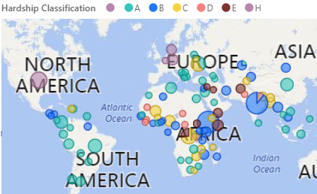
Populations Reached
Notes:
The United Nations use a classification system to indicate hardhip of duty stations. As you can see from the map above, big chunks of our audience come from country offices and regional hubs. The HQ is in NYC. Our goal is to increase the number of participants in country offices, particularly those in D and E duty stations. We are also creating programmes to cater to these populations with the goal of reaching those farthest behind first. Just like UNDP attempts to do with its programmes for development across the world.

Slide 31
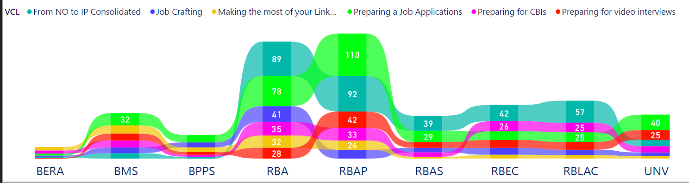
Trends and Insights
External Relations | Management | Programmes | Africa | Asia Pacific | Arab States | Europe | Latin American and Caribbean | UN Volunteers
Notes:
As far as career management is concerned, our challenges are multi-fold and include: building a growth-based career model where employees envision career as a learning journey rather than another step in the ladder; accommodating career aspirations in an environment of dwindling resources where temporary appointments become the norm; aligning career management with capability enhancement to increase employee’s employability while helping the organization fulfill its mission, among many other factors.
As you can see from our participant from Africa and Asia Pacific, basic topics such as Preparing a Job Application tend to be the most popular, which indicates our populations there may need a little more focus on ‘basic career management skills.” Our goal is to enhance their skills so in the future, we can have the entire organization working on topics such as “The impact of Emotional Intelligence on your Career,” Resilience and Professional development in the United Nations System, Careers of the Future. In other words, we would like to have our audience mature in the knowledge of career management concepts so we can take the conversation and the initiatives to a higher level, including that of capability enhancement. We would like to increase their employability while their performance and ability to meet organizational goals also increase.

Slide 32
UNDP #careerexperience pitch-off
Results
In just 5 months, VCL reached 2k+ personnel including live sessions and recordings
👤
Notes:
Results from registration data collected from each Virtual Career Lab inform our decisions on future topics and help us gauge the ‘learning temperature’ across multiple audiences in our talent ecosystem.
By December 2017, we will address the lack of personal attention typical of virtual sessions by pre-training local Talent Development Managers prior to the VCLs. Their role will be to facilitate the session as the HQ speakers provide content throughout the lab and employees attend sessions in groups across country offices. These on-site facilitators over multiple locations will assist participants during exercises and interact live with HQ. This will increase engagement and the exchange of information among participants making for a more enriching activity where individuals learn by doing in groups in a cost-effective and innovative manner.
We would also like to focus on greater capability-enhancing topics for targeted audiences such as HR professionalization, Finance, Programme Management and other functional areas.
We will conduct VCLs in other UNDP official languages like Spanish and French. This is to fulfill the needs of employees in country offices who are more comfortable learning in their native/official country languages.

Slide 33
UNDP #careerexperience pitch-off
Results
Percentages | Insights
~70% | Report they have changed behaviors after attending VCL Session(s)
~80% | Report VCL acted as motivator to further learning as part of career management
>50% | Report main career management goal is to “grow professionally within their own role or lateral move
>66% | Participated in VCL for FIRST TIME
>50% | From Country Officers and not HQ or Regional Hubs
>90% | Plan to attend a session again
>88% | Report VCL content was relevant to Career Management goals
Notes:
>50% of respondents report their main career management goal is to grow professionally within their own role or lateral move, which supports our promotion of a growth-based career model
>66% of respondents report participating in a Virtual Career Lab session for the first time, which means we typically reach a new range of users with every session
Interest in sessions correspond to a wide range of UNDP employees regardless of tenure
>50% of respondents are based in country offices, followed by HQ, Regional Hub and Other respectively
Samples indicate >90% of respondents are likely to attend a session again whereas >88% report the VCL content was relevant to their career management goals

Slide 34

UNDP #careerexperience pitch-off
Results
“Hugely useful and of great interest…”

Slide 35
UNDP #careerexperience pitch-off
Results
“Changed my way of thinking in mentoring career growth…”

Slide 36
UNDP #careerexperience pitch-off
Results
“I have learnt that one has to constantly develop themselves in order to remain relevant.”

Slide 37
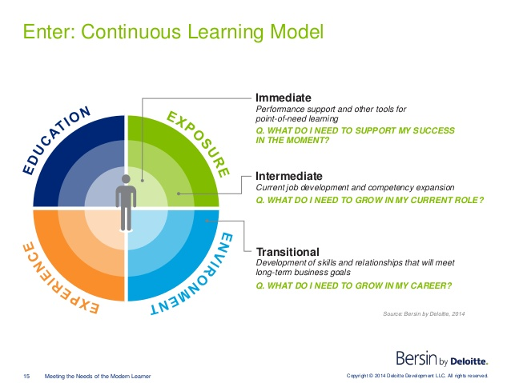
UNDP #careerexperience pitch-off
What we learnt
Results help us gauge the ‘learning temperature’ for career management across multiple audiences in our talent ecosystem
Balance between preparing employees in current role for future role
Notes:
4 E’s of continuous learning: Education, Experience, Exposure and Environment
Results help us gauge the ‘learning temperature’ across multiple audiences in our talent ecosystem
Results help us gauge the ‘learning temperature’ for career management across multiple audiences in our talent ecosystem
Balance between preparing employees in current role and for future role
The whole talent ecosystem should be involved- managers, peers, senior leaders etc.

Slide 38

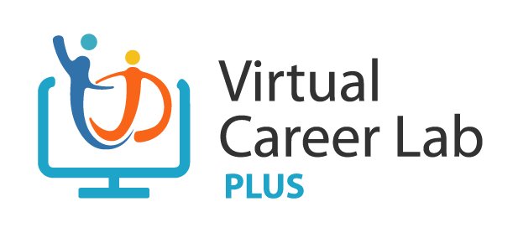


UNDP #careerexperience pitch-off
What’s next for us?
Increase in participation in C D E
Duty Stations
Live facilitation of on-site trainers across the globe
Career Management Academy for Women
Continue process to support move from Level 2 to Level 4
Notes:
Virtual Career Lab PLUS
Maturing topics for our growing audiences and increase participation of C,D, and E Duty Stations
Targeted programmes for women in the field and HiPo’s with VCL and VCL-PLUS support
Continue process to move UNDP to a level 2 to a level 4 in the High Impact Model for Learning Organizations

Slide 39

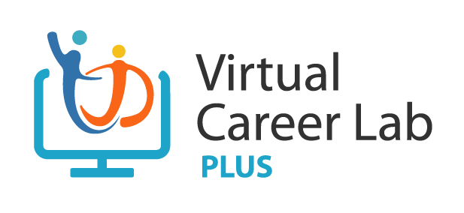
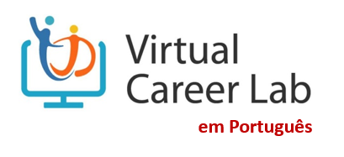

Always on and always available resources
en Español
Em Portugues
Notes:
Brief introduction to each speaker.
Segway: Speaking of creating a self-driven career management culture, it is important to keep in mind the importance of the concept of “Continuous Learning.”

Slide 40


UNDP’s Virtual
Career Management Workshop*
Wednesday, April 4th 2018
2pm-5:30pm (NYC)
*Employees can access the latest
Learning@UNDP Newsletter
to Register
Notes:
French:
Comme vous pouvez le constater à partir de la liste sur cette diapositive, nous prévoyons d'offrir une variété de sessions de VCL. Notre sujet aujourd'hui est «Histoires de carrière: passer d’un poste national a un poste international». Nous avons déjà animés des séances sur ‘la préparation d’un entretien vidéo à distance ’, sur ‘Comment optimiser votre profil Linkedin’ et comment ‘se préparer à des entretiens axées sur les compétences’. Au cours des prochains mois, vous pourrez également assister à des sessions de sujets différents ;
- Lister quelques éléments des diapositives.
Notre objectif est de rendre certaines de ces sessions disponibles dans d'autres langue, comme l’espagnol et le français.
---------------------------------------------------------------------------------------------------------------------------------------------------------------------------------------------
English:
As you can see from the list on this slide, we plan on offering a variety of learning lab sessions. Our topic today is “Career Stories: From National Officer to International Positions.” We have already offered sessions on Preparing for a Video Interview, Making the Most of Your LinkedIn Profile, and Preparing for Competency-Based Interviews. In the next months, you will also be able to attend sessions focusing on
- List a few items from the slides.
- Our goal is to make some of these sessions available in other languages in the future, such as in Spanish and in French.

Slide 41


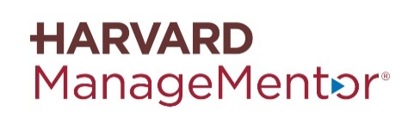

Designing Modern Effective Career Management Workshops
AGENDA
Quick Personality Assessment
Changes in the workplace and its relevance to a Growth-Based Career
Review at-home self-assessment results:
  how are “locus of control” and “resilience” associated to your career management strategy?
Exercise 1: Looking back
  What are the themes in your professional career?
Exercise 2: Looking to the future
  What’s your desired job 5-7 years from now (private exercise)
Exercise 3: Looking at the present
  Creating SMART goals for career growth in 2018
Discussion
  Dealing with change and career management while at UNDP
  Final Debrief
PREP MATERIALS
What Are Your Values? Deciding What’s Most Important in Life
Think Strategically about Career Development (5 min) – HBR
Are you Prepared for the Careers of the Future (<5min) – Bersin by Deloitte
Career Path is Dead. Long Live Careers (<7 min) – CEB/Garner
Building Effective Career Partnerships – (4 min) CEB/Garner
Infographic – The New Path Forward – Growth-Based Careers (2 min) – CEB/Garner
RESOURCES

Slide 42

Career Management Programmes
Notes:
Engagement surveys consistently identify that women, particularly those in Emergency Duty Stations have very different experiences regarding Career Management. Data-driven career management programmes can support these women gain useful skills to find alternative routes for growth including considering lateral roles to foster job growth, identification of mentors and sponsors to support their professional development and awareness of typical pitfalls associated with being a woman in International Civil Service Environment and in professional life overall.

Slide 43
Career Management Programme Sample
Access Harvard ManageMentor on Career Management
Follow up via webinars targeted at development areas
Eligibility to compete for in person and virtual detail assignments
Self-Assessment tools on Career Management Behaviors
Career coaching experience in groups

Slide 44
Replicability and Scalability Ideas
200 women at all levels exposed to a growth-based career model and continuous learning
Scalability and Replicability test for other potential low-cost, high-impact and wide-reaching initiatives
Potential pools for virtual assignments, detail assignments and leadership programmes
Promotion of organization in gender-parity support with initiatives with high scalability
Promote UNDP as employer of choice with high-impact initiative. Ability to create a mini-case study and strengthen our business case for future initiatives
Potential increase in engagement and levels of satisfaction with career management as measured by engagement surveys
Notes:
Employer of choice
Mini-case study
Disruptive
Gender work as part of initiative
Potential ROIs – retention – increase in engagement as per survey –

Slide 45
Aligning Career Management with Capability Enhancement
Micro-Project of relevance to career goals and CO’s needs
Self- assessment on career management behaviors
Online training on Project Management by Coursera (4 weeks) and a Harvard Manager Module of Choice
Final assessment to evaluate change in career management behaviors
Best project award for participant and mentor
Project implementation with guidance from internal and external mentors
Mentoring and feedback on micro-project
4 months

Slide 46

Virtual Development Assignment Programme
Participants engage in a specific or multiple projects within HR and other pillars to support the design, preparation, implementation and evaluation of tools, resources, and material. The purpose is to support a Continuous Learning culture and growth-based careers at the Organization.
Duration | Grade | Process
8 weeks – 2-4 hours per week | Open to staff at any grade | Eligibility, Application and Supervisor Approvals
Notes:
The Talent Development Unit (TDU) works in building the capacity of Talent Development Managers across multiple disciplines at UNDP to enhance the capability of our organization and provide development opportunities to its staff.
The Talent Development Unit (TDU) offers this development opportunities the TDM virtually/online from their current duty station. The Virtual Detailed Assignment for Talent Development Managers promotes knowledge sharing to build on their capacity and overall framework. The TDM will participate in multiple project within TDU’s pillars to support the design, preparation, implementation and evaluation of tools, resources, and webinars to support the growth-based careers and Continuous Learning culture in UNDP.

Slide 47


Talent Exchange Programme
For a limited period of time, a staff member can exchange positions with a staff member from another department to enhance knowledge sharing and capacity building across multiple disciplines in the organization.
Dept 1
Dept 2
Duration | Grades | Process
4-12 weeks | G6-P5 | Eligibility, Application and Supervisor Approvals

